Slide 1


Cyberbullying Detection
By:
John Hani
Mohamed Nashaat
Mostafa Ahmed
Zeyad Emad (Team Leader)
Under supervision of :
Dr. Eslam Amer
Eng. Menna Gamil

Slide 2



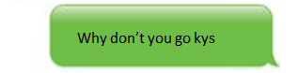
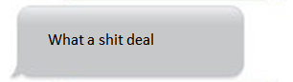
You’re
Trash
Personal pronoun used when directly addressing people
An offensive word when combined with personal pronouns creates a cyberbullying sample

Slide 3
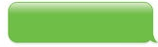
Why
Don’t
you
go
kys
Kys is a slang word which stand for kill yourself also considered as a cyberbullying sample
http://www.noswearing.com/dictionary

Slide 4
What
a
deal
A rather offensive word but no pronouns were found in that sentence implying the sentiment of discomfort or irritation

Slide 5
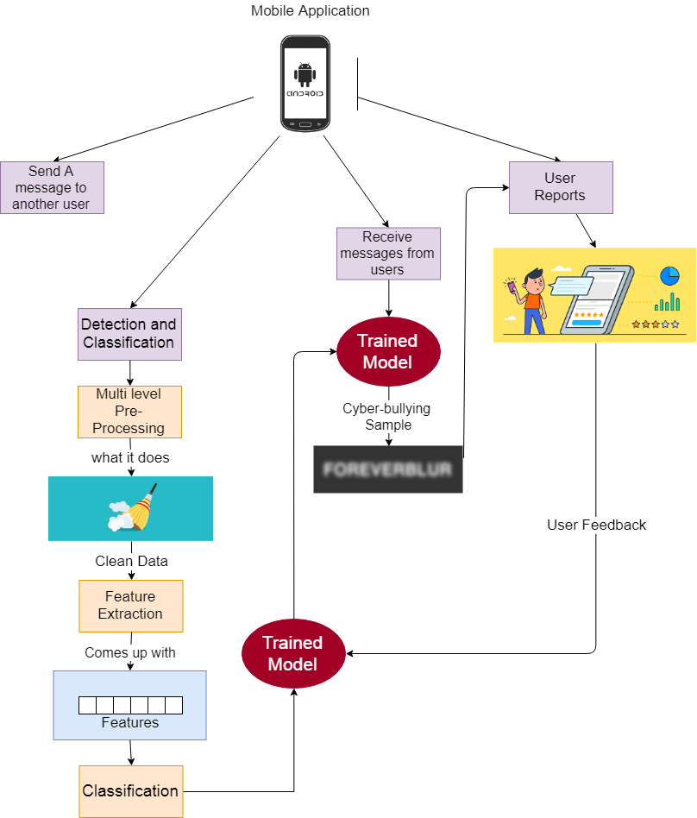

Slide 6
Objective
In previous cyberbullying detection frameworks there has been a problem in detecting false positive cyberbullied cases.
The accuracy in these papers is not high enough and could be improved.

Slide 7
Functional Requirement
User | Login Sign Up Update Logout Rating
Messages | Send messages & Receive messages Encrypt & Decrypt Copy & Paste message
Processing | Preprocessing Feature extraction Classification
System | Notify Result Upgrade Classifier

Slide 8



Non Functional Requirements
Security
Maintainability
Portability
Have Encryption and Decryption
Self Learning
Both Desktop and Android

Slide 9
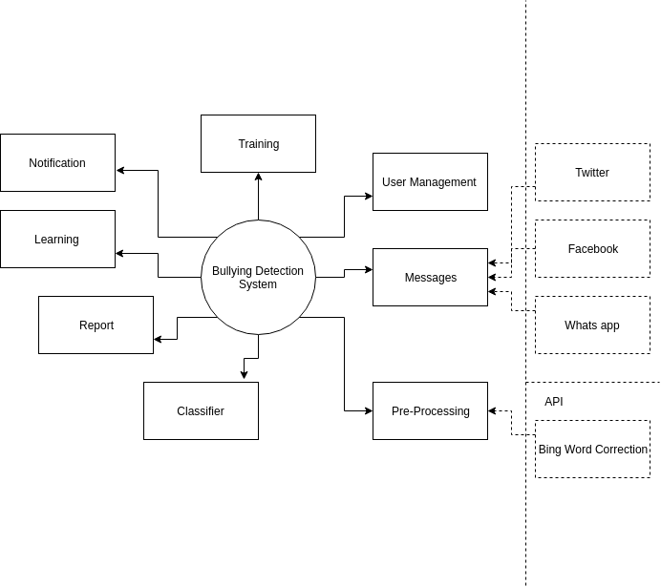
Context Diagram

Slide 10
User Management: Responsible for the Management of the Users Roles
Pre-Processing: Limitization, Stemming,Tokenization, Word Correction Bing API for correction
Processing: (SVM , Random Forest, Naive Bayes)
Reports: Are automatically generated reports about the system overall the number of bully message detected , etc…
Learning: Self-Learning for the system based on the decision taken by the supervisor about the user rating
Notification: Notify the user about the new messages and bully messages received
Training: Train the model by data set or wrong classification
Messages: Receive messages from Twitter, Facebook , Whatsapp API

Slide 11
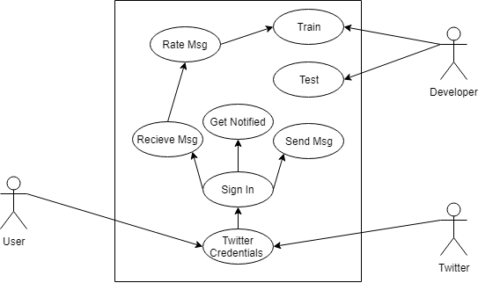
Use Case

Slide 12
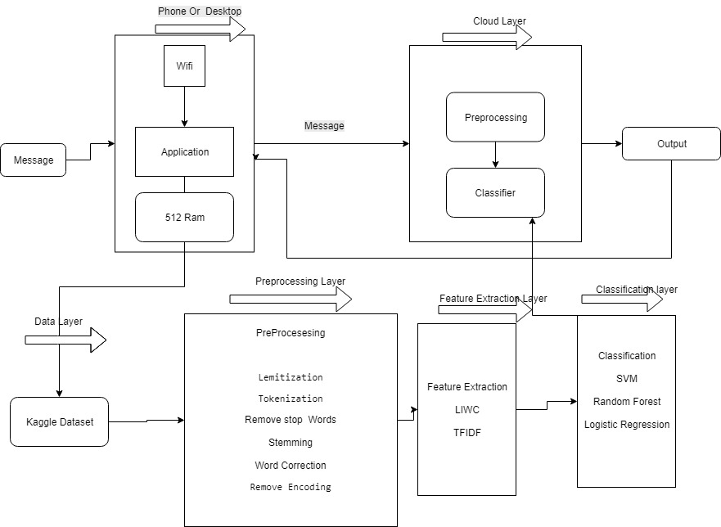
Block Diagram

Slide 13
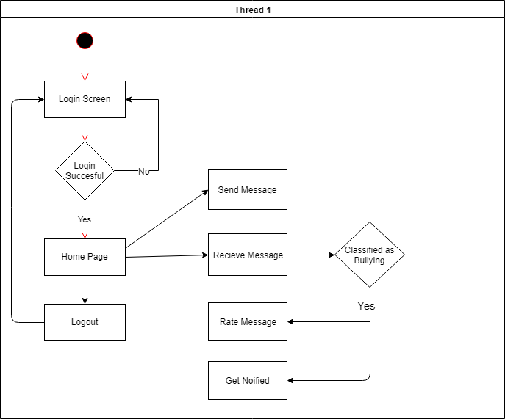
Activity Diagram

Slide 14
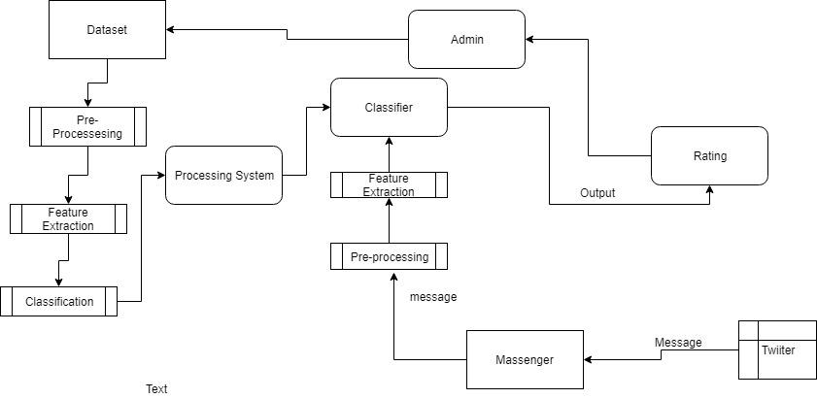
Data Flow Diagram

Slide 15
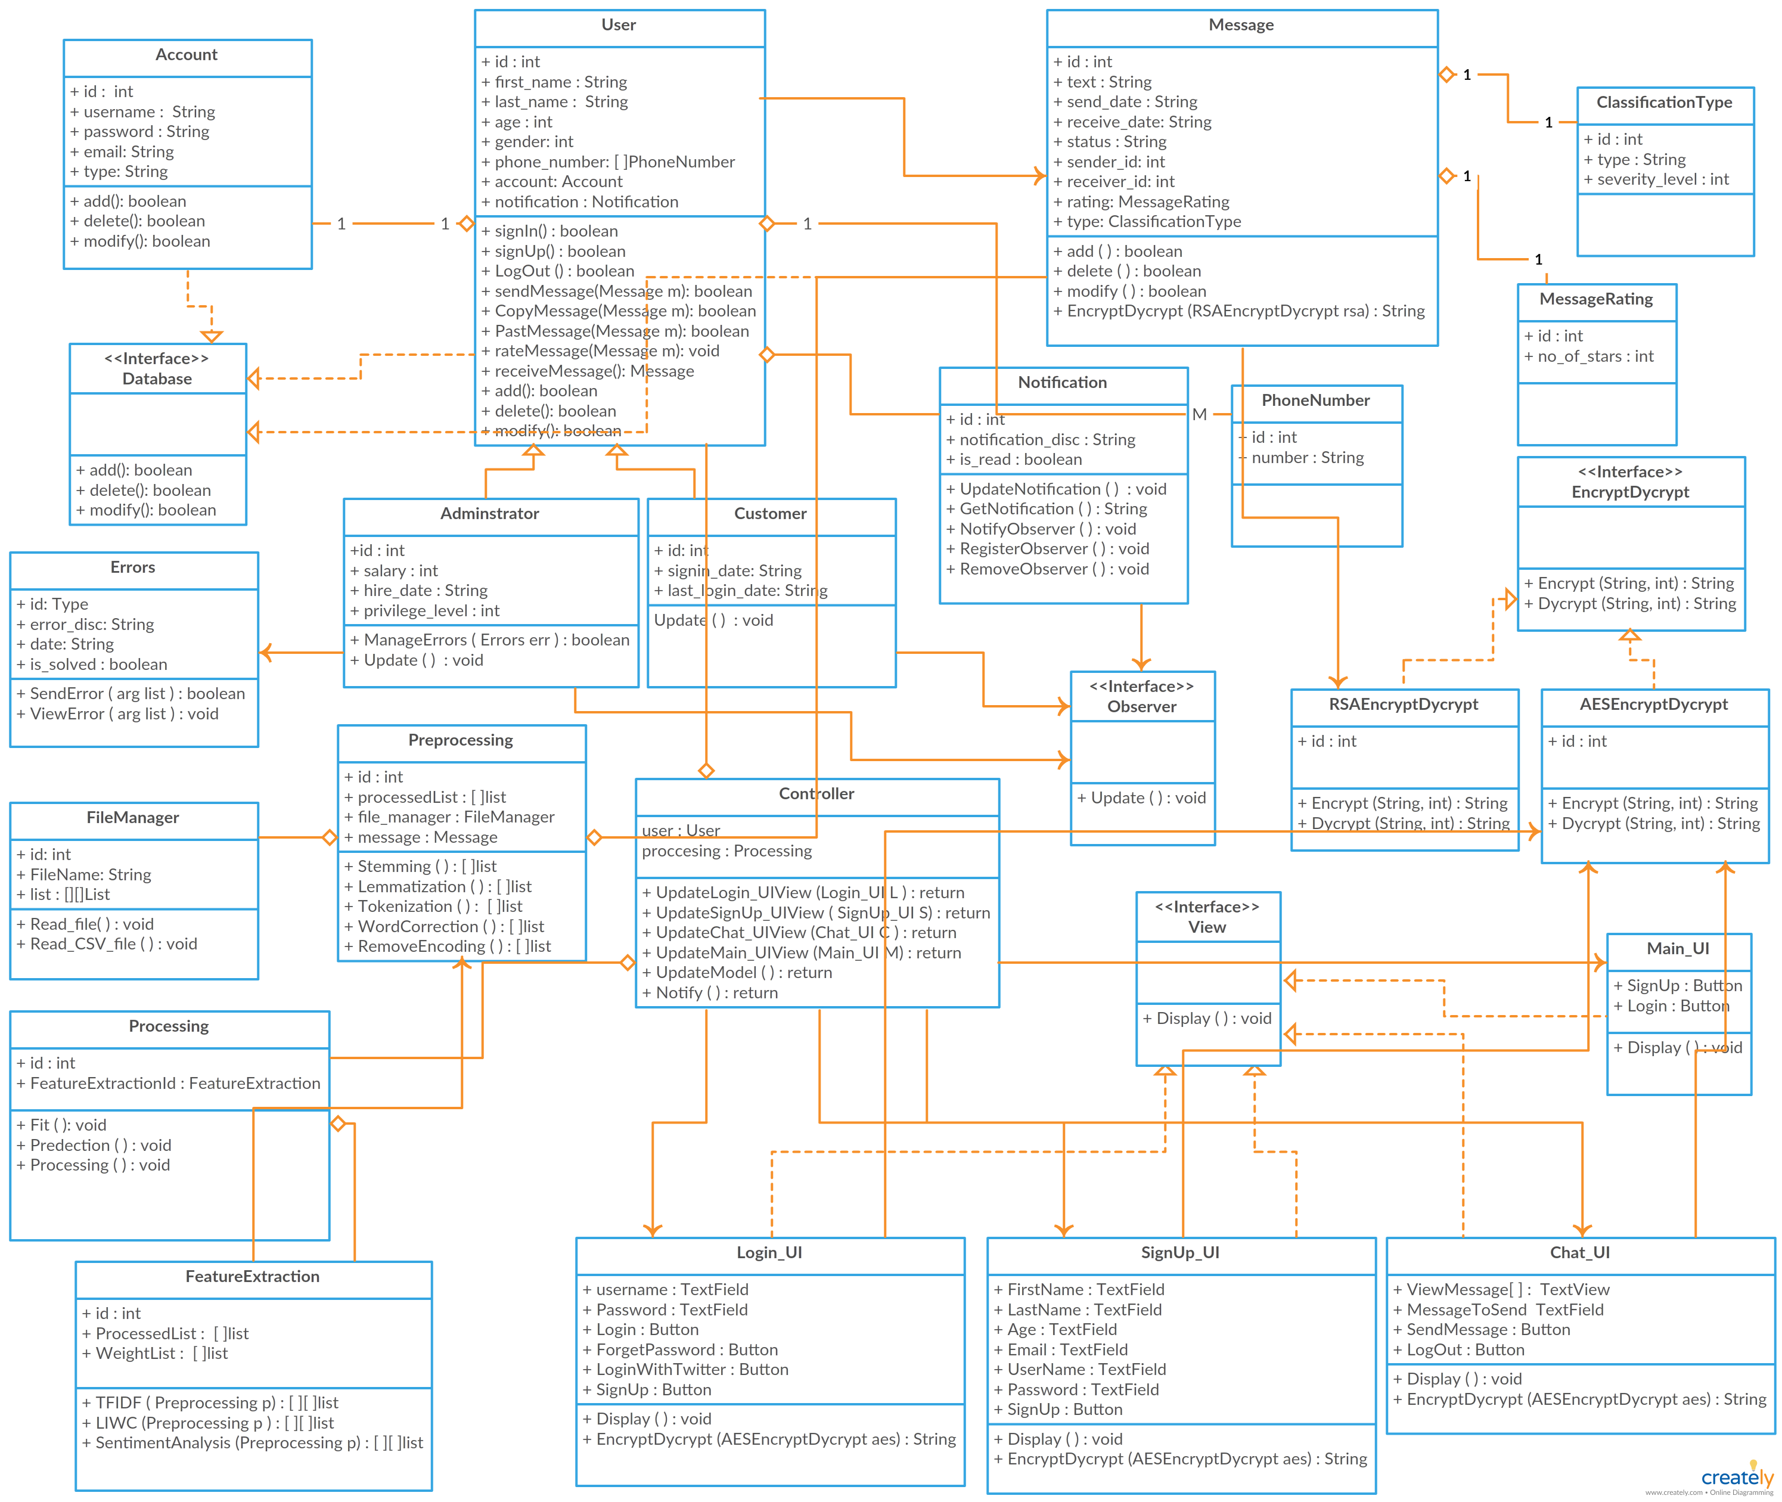
Class Diagram

Slide 16
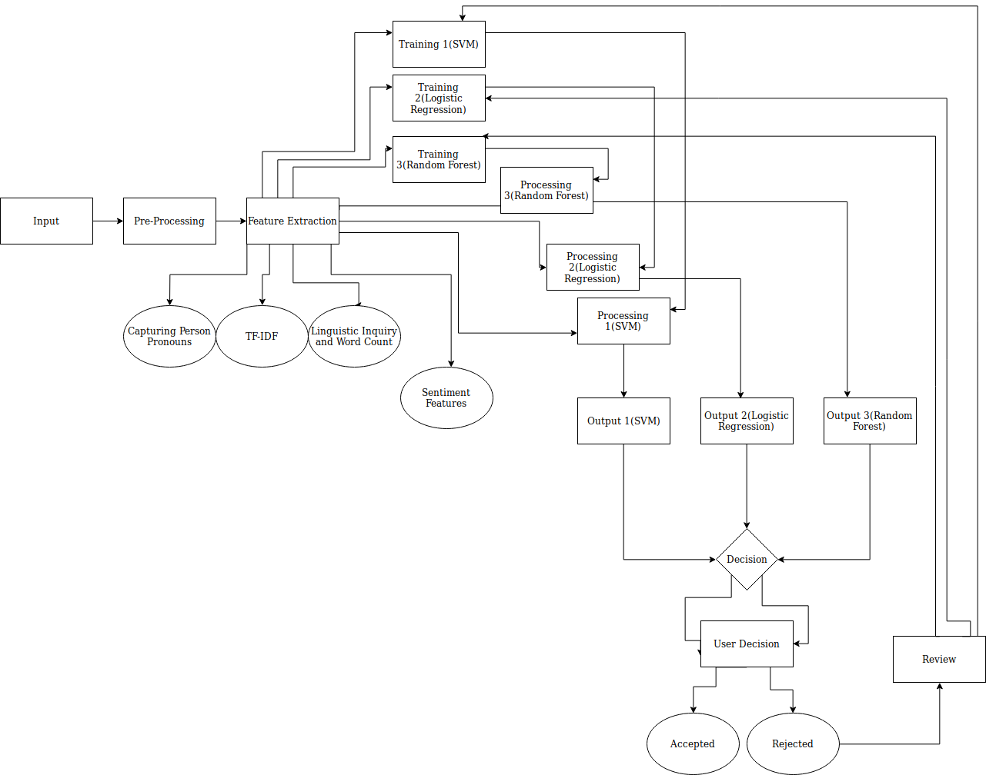
System Overview
Processing 2 ( Naïve Bayes )

Slide 17
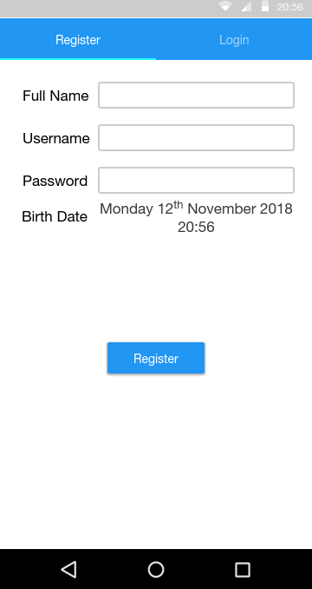
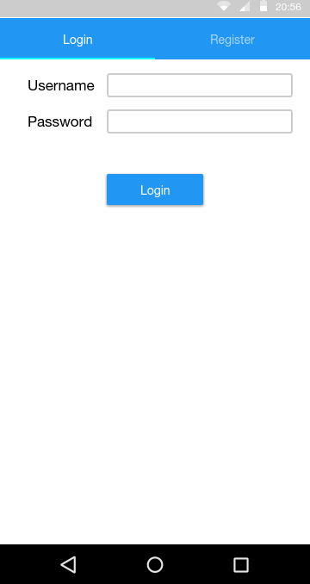
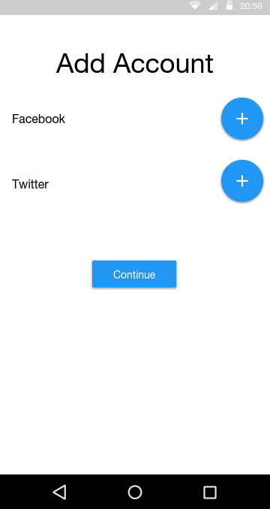
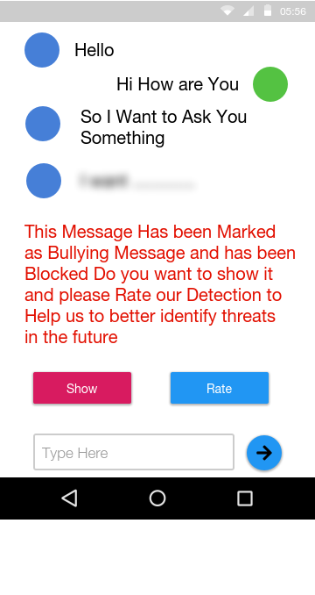
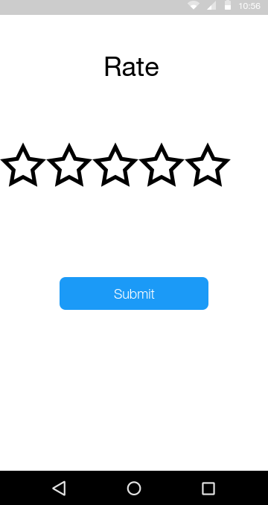
GUI

Slide 18
Demo

